Slide 1
DIGITAL LOGIC DESIGN PROJECT
Design of 4-Bit Binary-to-Decimal Conversion & Display System
Combinational Logic Gate Implementation with 7-Segment Display Decoding
PROJECT TEAM MEMBERS
Vignesh
Manikanta
Ram Charan
Praveen
4-Bit BCD Decoder Module

Slide 2

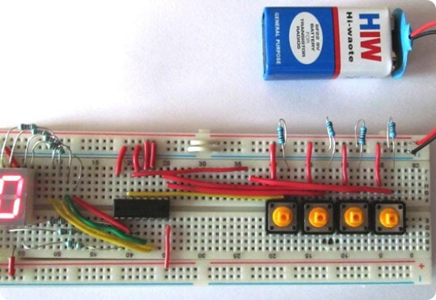
SYSTEM OVERVIEW
Project Objectives & Significance
Binary Conversion Objective
Convert 4-bit binary inputs (0000 to 1001) into human-readable decimal digits.
Logic Gate Integration
Synthesize optimized Boolean expressions using AND, OR, and NOT gates.
Hardware Display Interface
Drive a 7-segment LED display using synthesized line-control outputs.

Slide 3



ARCHITECTURE
System Block & Data Flow Diagram
4-Bit Binary Input
Decoder Logic Network
7 Output Lines
7-Segment Display
4 toggle lines (D, C, B, A) representing values 0 to 15.
Combinational gate array calculating 7 segment functions.
Parallel driver signals mapped from segment 'a' to 'g'.
Visual readout rendering decimal numbers 0 through 9.

Slide 4
TRUTH TABLE & DESIGN SPECIFICATION
BCD to 7-Segment Output Mapping
Decimal | D | C | B | A | a | b | c | d | e | f | g
0 | 0 | 0 | 0 | 0 | 1 | 1 | 1 | 1 | 1 | 1 | 0
1 | 0 | 0 | 0 | 1 | 0 | 1 | 1 | 0 | 0 | 0 | 0
2 | 0 | 0 | 1 | 0 | 1 | 1 | 0 | 1 | 1 | 0 | 1
3 | 0 | 0 | 1 | 1 | 1 | 1 | 1 | 1 | 0 | 0 | 1
4 | 0 | 1 | 0 | 0 | 0 | 1 | 1 | 0 | 0 | 1 | 1
5 | 0 | 1 | 0 | 1 | 1 | 0 | 1 | 1 | 0 | 1 | 1
9 | 1 | 0 | 0 | 1 | 1 | 1 | 1 | 1 | 0 | 1 | 1
Valid Range (0–9)
Standard BCD combinations map directly to digits 0 through 9.
Don't Care States (10–15)
Binary states 1010 to 1111 leverage K-map don't cares (X) for simplification.

Slide 5
LOGIC OPTIMIZATION
Karnaugh Map Minimization
K-Map Expression Grouping
Four-variable Karnaugh maps resolve minimal Sum-of-Products (SOP) forms for each output segment.
Representative Expression (Segment a)
a = D + B + (C · A) + (C' · A')
Gate Count Reduction
Reduces overall propagation delay and hardware IC package requirements.

Slide 6

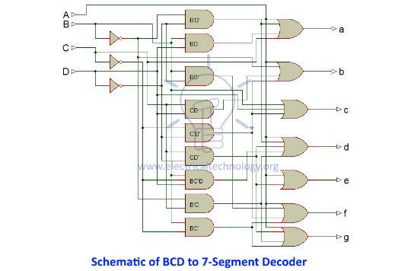
CIRCUIT DESIGN
Gate-Level Logic Implementation
Primary Logic Elements
AND gates for minterm evaluation, OR gates for combining minterms, NOT inverters for bit complements.
Universal Gate Conversion
Circuit structures easily adapt to NAND/NOR universal gate implementations for physical chip assembly.
Parallel Processing
Combinational logic computes all seven segment states in parallel with minimal gate latency.

Slide 7

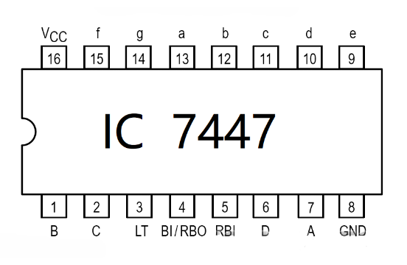
HARDWARE INTEGRATION
IC 7447 / 7448 Decoder Implementation
7447 BCD Decoder IC
Active-LOW output decoder specifically designed for common-anode 7-segment LED displays.
7448 BCD Decoder IC
Active-HIGH output decoder specifically designed for common-cathode 7-segment displays.
Control Inputs
Includes Lamp Test (LT), Ripple Blanking Input (RBI), and Blanking Input (BI/RBO).

Slide 8
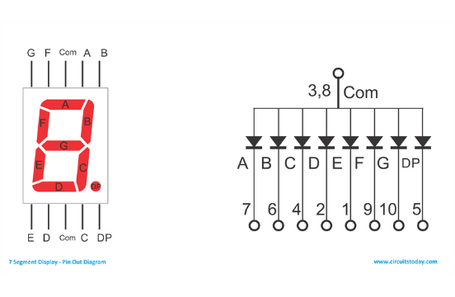
DISPLAY INTERFACE
7-Segment Display Configurations
Common Cathode (CC)
All LED cathodes tied to GND. Activated by HIGH logic signals (1).
Common Anode (CA)
All LED anodes tied to VCC. Activated by LOW logic signals (0).

Slide 9



APPLICATIONS & RESULTS
Practical Applications & Summary
Digital Calculators
Digital Multimeters
Embedded Timers
Converts internal binary computation results into decimal readout numeric displays.
Displays measured voltage, current, and resistance decimal values precisely.
Used in microwave appliances, digital clocks, and industrial counters.

Slide 10
PROJECT PRESENTATION COMPLETED
Thank You!
Questions & Answers
PRESENTED BY GROUP MEMBERS
Vignesh
•
Manikanta
•
Ram Charan
•
Praveen

